Slide 1

An Overview on SHM Dataset of Bridges in Quebec with Preliminary Analysis
Zachary Hamida, Ph.D. Candidate
James-A Goulet, Advisor
Total Slides: 20

Slide 2
Introduction
Structural Health Monitoring (SHM)
• Structural Health Monitoring (SHM)
The process of implementing damage identification strategy for engineering infrastructure [1].
• Types of SHM Strategies based on Collecting Data
1- Visual Inspections
2- Monitoring System
3- Hybrid system of both systems
Notes:
These damage identification strategies are mainly dependent on the information collected about structures. Therefore, the shm strategies can be classified into: 1. whereby the information about the structure is collected through on the site inspectors \ 2. monitoring systems: the information is collected from sensors attached to the structure or a hybrid of both systems, whereby data is collected through inspectors and sensors.

Slide 3
Introduction
Structural Health Monitoring (SHM)
• Visual Inspections vs Monitoring Systems
 | Visual Inspection | Monitoring System
Measurements Frequency | Yearly basis | Daily basis (Could be Continuous)
Assessment | Broad | Limited
Cost | Cost is a function of inspection frequency | High initial cost + unpredictable maintenance cost
Disadvantages | 1- Intervention timing 2- Variability 3- Accessibility (i.e. overpasses) | 1- Complexity 2- Maintenance 3- Automated Detection System
Notes:
Each of the aforementioned systems has advantages and disadvantages, and here are some on the surface ones…
For example the 1
And the 2
Other disadvantages
So this was the review on the shm methods.

Slide 4
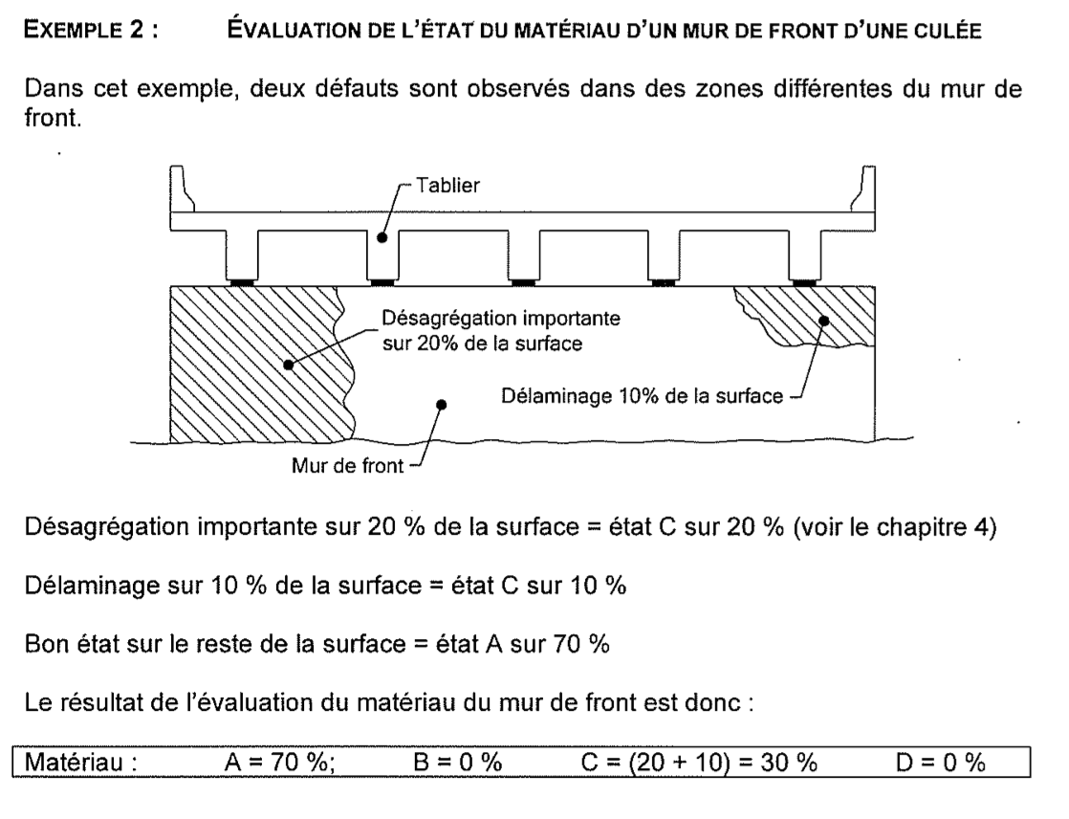
Introduction
SHM
Inspection System
• Bridge Inspection System of Quebec
• Manuel d'inspection des structures
Inspectors team formation (A1, A2, B1, B2).
Types of structures and elements category (i.e. Pont en arc, Poutre…etc.).
Inspections frequency (2-4 years).
Evaluation system.
Structural element condition is composed of 4 categories:
A: Excellent, B: Good
C: Damaged, D: Seriously Damaged
A+B+C+D=1 unit volume
Notes:
Going back to the dataset of quebec, it was generated depending on visual inspection method which was illustrated in details in the Manual d’inspection des structures.
The manual detail the…
An Example of inspection for structural element,

Slide 5
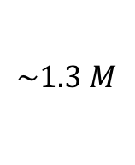
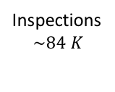
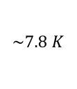
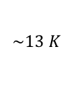
The Dataset
Data Components
• MTQ Dataset Organization
Structural Elements
Bridges
Inspectors $719$
Inspectors 719
Interventions
$$\sim 13 K$$
$$\sim 1.3 M$$
Inspections
$$\sim 84 K$$
$$\sim 7.8 K$$
Notes:
So the dataset is composed of the following in terms of size:

Slide 6
The Dataset
Data Components
• Structural Elements Dataset
Element details (i.e. ID, type, material and position)
Inspection date and evaluation (A%, B%, C%, D%)
• Structures (Bridges) Dataset
Structure details (i.e. ID, type, construction year, location and status)
Structure loads (i.e. annual average of daily truck load DJMA)
• Inspectors Dataset
Inspector details (i.e. ID, name and inspection procedure ID)
• Interventions Dataset
Structure ID
Cost and yearly schedule of intervention progress

Slide 7
Objective
Data Analysis Objective
Condition
100
Element condition time series
Condition prediction
Predict
Plan
Optimize
0
2014
2016
2018
Year
Condition
Intervention
100
0
Year
2014
2016
2018
2020
Notes:
The ultimate objective of the analysis on the dataset is to obtain an accurate future prediction of the state for a given structural element (long term)

Slide 8
Analysis
Dataset Pre-processing
• Main challenges to expect with the dataset
Loading the dataset.
The four metrics evaluation system (A, B, C, D).
Handling Categorical Data (i.e. Bridge’s element material).
Covariates selection for the prediction system.
Missing data.
Bias (common in health datasets).
The Variability (inspectors evaluation is subjective).
Notes:
So to start with I’ve listed a summary for the initial challenges that we could encounter,
Starting from

Slide 9
Analysis
Problems
Loading Big Datasets
• Loading the dataset
Database connection depending on the database file type (generic method).
Example code
Matlab Datastore (specific method).
datasource = 'dbname'; username = 'username'; password = 'pwd';
driver = 'org.postgresql.Driver';
url = 'jdbc:postgresql://host:port/dbname';
conn = database(datasource,username,password,driver,url)
selectquery = 'SELECT * FROM inventoryTable';
data = select(conn,selectquery);
data(1:3,:);close(conn);
EDStore=datastore('T_elements_inspectes_historiques_2017-07-07.csv', 'TreatAsMissing','NA');
EDStore.SelectedVariableNames = {'x_A','x_B','x_C','x_D'};
EData = readall(EDStore);
Notes:
As for loading the dataset, there are two major procedures on is generic the other on is specific but both have the same concept that is the data is not loaded in but linked.

Slide 10
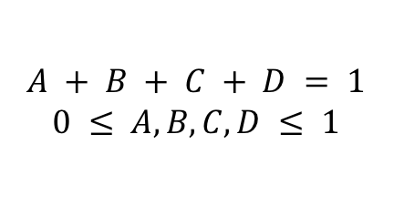
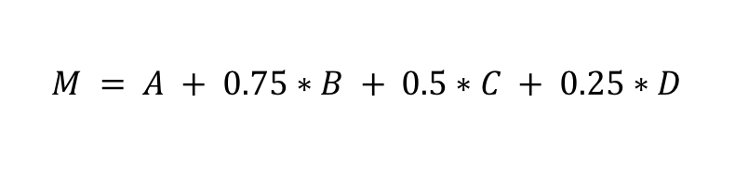
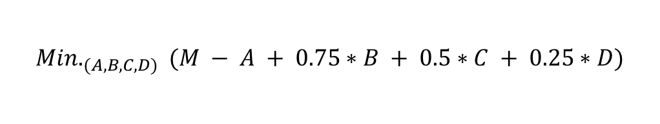
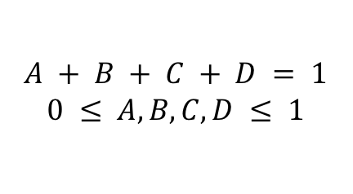
Analysis
Problems
Loading
Data Conversion
• Four Metric System Alternative
The evaluation system formulation (A, B, C, D)
A is the percentage of volume of excellent area of the element,
B is the percentage of volume of good area of the element,
C is the percentage of volume of damaged area of the element,
D is the percentage of volume of seriously damaged area of the element.
$$A + B + C + D = 1$$
$$0 ≤ A, B, C, D ≤ 1$$
$$M = A + 0.75∗B + 0.5∗C + 0.25∗D$$
To revert back to the old metric (A, B, C, D):
$${Min.}_{(A,B,C,D)} (M − A + 0.75∗B + 0.5∗C + 0.25∗D)$$
Such that
$$A + B + C + D = 1$$
$$0 ≤ A, B, C, D ≤ 1$$
Notes:
Moving forward, the other challenge in the dataset is the four metric system whereby we hv four metrics to measure the condition, these four metrics represent the categories of the condition. Therefore they can be represented in cumulative metric since they sum up to one unit.
This metric can be written as:
Which most likely true as long as these two conditions hold:
The higher the metric M the better the condition and vice versa.
For example if D was 100 all other categories (A, B, and C) will be 0. Therefore M will be 25
On the other hand, if A was 100 then all other categories (B, C and D) will be 0. Therefore M will be 100

Slide 11
Analysis
Problems
Loading
Data Conversion
• Categorical Data
Can be represented as integer classes in some prediction systems (i.e. ANN)
However, if the prediction system depends on the similarity among covariates (i.e. GP), the integer class representation is not feasible anymore.
One potential solution for this problem is categorical mapping.
Categorical mapping assign a value to each category depending on its similarity to other categories.
Material
Beton
Beton BHP
Steel Regular
Steel Intempre
Bois
Aluminium
Béton précontraint
Material
1
2
3
4
5
6
7
 | Wood | Beton | Metal
Beton | 0 | 1 | 0
Beton BHP | 0 | 0.5 | 0
Steel Regular | 0 | 0 | 1
Steel Intempre | 0 | 0 | 0.5
Bois | 1 | 0 | 0
Aluminium | 0 | 0 | 0.25
Béton précontraint | 0 | 0.25 | 0
Original
Integer classes
Categorical Mapping
Notes:
Again, moving forward, handling categorical data. In our case the categorical data could be the material of the element which is an important factor in the element behavior.

Slide 12
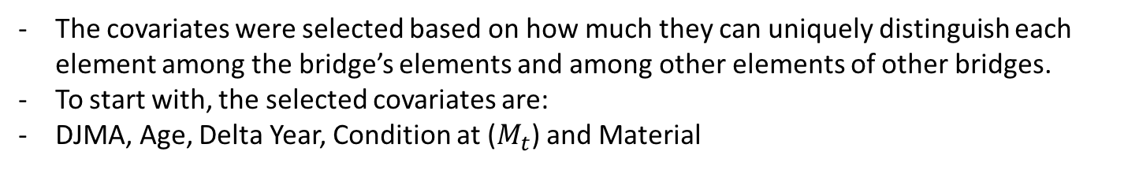
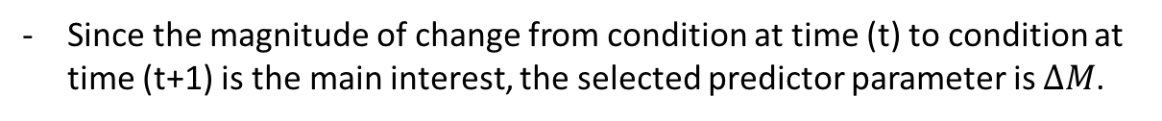



Analysis
Problems
Loading
Conversion
Prediction System
• Covariates Selection
The covariates were selected based on how much they can uniquely distinguish each element among the bridge’s elements and among other elements of other bridges.
To start with, the selected covariates are:
DJMA, Age, Delta Year, Condition at ($M_{t}$) and Material
• Predictor Parameter
Condition
100
$$M_{(t)}$$
Since the magnitude of change from condition at time (t) to condition at time (t+1) is the main interest, the selected predictor parameter is $∆M$.
$$M_{(t+1)}$$
$${∆M}_{(t+1)}$$
0
2014
2016
2018
Year
Notes:
So after handling all the initial problems with the dataset, we want to select the parameters that we would train our model on, the parameters were selected based on how uniquely they represent the structural element.

Slide 13
Analysis
Problems
Loading
Conversion
Prediction System
• Prediction Framework for time series (Gaussian Process)
Gaussian Process is a supervised learning framework to solve regression and probabilistic classification problems.
Common terminology used: Prior, Posterior, likelihood and Kernel (Covariance function)
Advantages | Disadvantages
Prediction with confidence interval (Variance) | Training data is always needed to perform prediction
Versatile through Kernels | The curse of dimensionality (at super high number of dimensions)
Notes:
How much changes in input are associated with changes in output
Depends mainly on the similarity among the training data covariates to infer the predictor value.
The similarity among covariates is computed through kernels (or covariance functions).

Slide 14
Analysis
Problems
Loading
Conversion
Prediction System
• Univariate Gaussian
Example on the bridges data:
Sample of 5 similar concrete bridges S1, S2, S3, S4 and S5 that has nearly the same age.
From each bridge we take one beam (poutre) to be evaluated.
The condition is assigned through a single metric [0-100] [poor- excelent]
We’ve evaluated one beam B1(blue), B2(orange), B3(green), B4(baby-blue) and B5(black) from each bridge and got the evaluations M1, M2, M3, M4 and M5.
Posterior (from bridge data)
0.1
Prior (from previous knowledge about structures
that has similar design and age)
Probability Density
0
Beam
Condition
0
70
80
100
2014
Notes:
To give a quick overview on what are the basis of GP we start with this example which contain the terminology

Slide 15
Analysis
Problems
Loading
Conversion
Prediction System
• Univariate to 2D Gaussian (Multivariate)
2D Prior
Posterior (from bridge data)
100
0.1
Condition in 2014
Probability Density
0
0
0
100
Condition in 2016
0
65
75
100
2016
Beam Condition
100
Measures for 2 set of times
Measures from finite to infinite set of times
=> Multivariate Gaussian to Gaussian Process
Condition
0
2012
2014
2016
2018
years
Notes:
How much changes in input are associated with changes in output
Depends mainly on the similarity among the training data covariates to infer the predictor value.
The similarity among covariates is computed through kernels (or covariance functions).

Slide 16

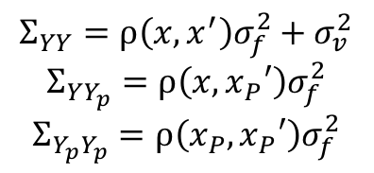

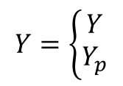
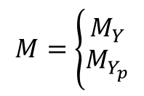
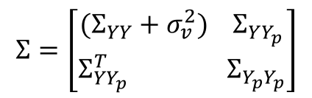


Analysis
Problems
Loading
Conversion
Prediction System
• Gaussian Process Equations
Gaussian Process is given by
$$Y=g\left(x\right)\sim N(M_{Y},Σ_{YY})$$
Prediction with Gaussian Process is done through conditional probability:
$$\operatorname{Pr}\left(Y_{p}=y | X_{p},D\right)$$
$$Σ_{YY}=ρ\left(x,x^{′}\right)σ_{f}^{2}+σ_{v}^{2}$$
$$Σ_{YY_{p}}=ρ\left(x,x_{P}′\right)σ_{f}^{2}$$
$$Σ_{Y_{p}Y_{p}}=ρ\left(x_{P},x_{P}′\right)σ_{f}^{2}$$
$$Y=\left\{\begin{aligned}Y \\ Y_{p}\end{aligned}\right.$$
$$M=\left\{\begin{aligned}M_{Y} \\ M_{Y_{p}}\end{aligned}\right.$$
$$Σ=\left[\begin{aligned}(Σ_{YY}+σ_{v}^{2}){ Σ}_{YY_{p}} \\ Σ_{{YY}_{p}}^{T} Σ_{Y_{p}Y_{p}}\end{aligned}\right]$$
Prior
$M_{p}=M_{Y_{p}}$+$Σ_{{YY}_{p}}^{T}Σ_{YY}^{−1}(y−M_{Y})$
Posterior
$$Σ_{p}=Σ_{Y_{p}Y_{p}}−Σ_{{YY}_{p}}^{T}Σ_{YY}^{−1}Σ_{YY_{p}}$$
Notes:
How much changes in input are associated with changes in output
Depends mainly on the similarity among the training data covariates to infer the predictor value.
The similarity among covariates is computed through kernels (or covariance functions).

Slide 17
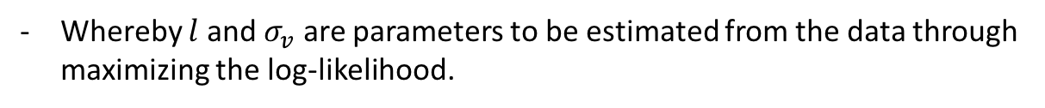
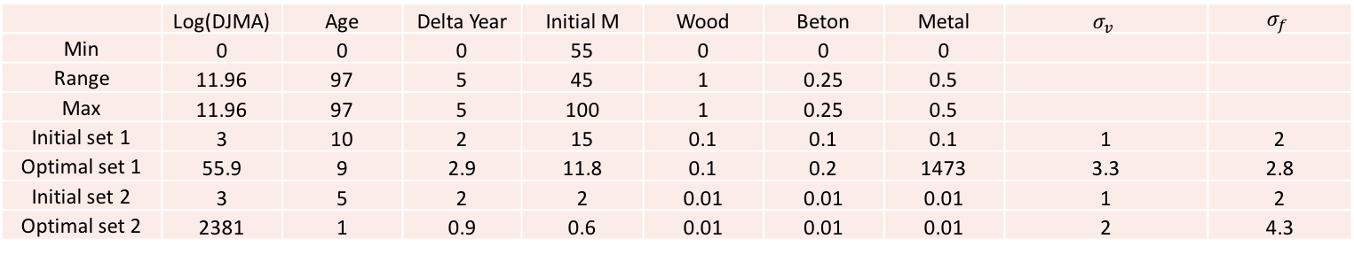
Analysis
Problems
Loading
Conversion
Prediction System
• Kernel (Covariance Functions)
Kernels help relate one observation to another.
Kernel example:
Squared Exponential Kernel:
$$Σ_{yy}=σ_{f}^{2} exp(−\frac{1}{2}{\left(x_{i}−x_{j}\right)}^{T}diag{\left(l\right)}^{−2}\left(x_{i}−x_{j}\right))$$
Whereby $l$ and $σ_{v}$ are parameters to be estimated from the data through maximizing the log-likelihood.
$$\log{p}\left(y | x,θ\right)=−\frac{1}{2}y^{T}Σ_{yy}^{−1}y−\frac{1}{2}log\left|Σ_{yy}\right|−\frac{N}{2}log2π ; θ=\left[σ_{f},l,σ_{v}\right]$$
 | Log(DJMA) | Age | Delta Year | Initial M | Wood | Beton | Metal | $$σ_{v}$$ | $$σ_{f}$$
Min | 0 | 0 | 0 | 55 | 0 | 0 | 0
Range | 11.96 | 97 | 5 | 45 | 1 | 0.25 | 0.5
Max | 11.96 | 97 | 5 | 100 | 1 | 0.25 | 0.5
Initial set 1 | 3 | 10 | 2 | 15 | 0.1 | 0.1 | 0.1 | 1 | 2
Optimal set 1 | 55.9 | 9 | 2.9 | 11.8 | 0.1 | 0.2 | 1473 | 3.3 | 2.8
Initial set 2 | 3 | 5 | 2 | 2 | 0.01 | 0.01 | 0.01 | 1 | 2
Optimal set 2 | 2381 | 1 | 0.9 | 0.6 | 0.01 | 0.01 | 0.01 | 2 | 4.3
Notes:
Lengthscale describes how smooth a function is. Small lengthscale value means that function too sensetive, large values characterize functions that change only slowly. Lengthscale also determines how far we can reliably extrapolate from the training data.
Signal variance σ2 is a scaling factor. It determines variation of function values from their mean. Small value of σ2σ2characterize functions that stay close to their mean value, larger values allow more variation. If the signal variance is too large, the modelled function will be free to chase outliers.

Slide 18
Analysis
Problems
Loading
Conversion
Prediction System
• Gaussian Process Application
Application:
Notes:
How much changes in input are associated with changes in output
Depends mainly on the similarity among the training data covariates to infer the predictor value.
The similarity among covariates is computed through kernels (or covariance functions).

Slide 19
Analysis
Problems
Loading
Conversion
Prediction System
• Handling Bias
Biased Sampling:
Discretize the domain into categories.
Perform random sampling from each category.
Group the all samples into a single dataset.
% example randomly from each category
r1=randi([1 length(Ind100)],1,150);
Biased Sampling with Data Replication:
Same as Biased Sampling.
Repeat the values that has less occurrence frequency.
repmat(P,10,1);
Notes:
How much changes in input are associated with changes in output
Depends mainly on the similarity among the training data covariates to infer the predictor value.
The similarity among covariates is computed through kernels (or covariance functions).

Slide 20
Analysis
Problems
Loading
Conversion
Prediction System
• Handling Bias
Notes:
How much changes in input are associated with changes in output
Depends mainly on the similarity among the training data covariates to infer the predictor value.
The similarity among covariates is computed through kernels (or covariance functions).

Slide 21
Discussion
Analysis
• Things to Improve on
Data pre-processing (i.e. adding more data, data sampling techniques… etc.)
Prediction models (i.e. different types of prediction models, boosting… etc.)
[1] Farrar, Charles R., and Keith Worden. "An introduction to structural health monitoring."
Philosophical Transactions of the Royal Society of London A: Mathematical, Physical
and Engineering Sciences 365.1851 (2007): 303-315.
[2] Agdas, Duzgun, et al. "Comparison of visual inspection and structural-health monitoring as bridge condition assessment methods." Journal of Performance of Constructed Facilities 30.3 (2015): 04015049.
Notes:
How much changes in input are associated with changes in output
Depends mainly on the similarity among the training data covariates to infer the predictor value.
The similarity among covariates is computed through kernels (or covariance functions).

Slide 22
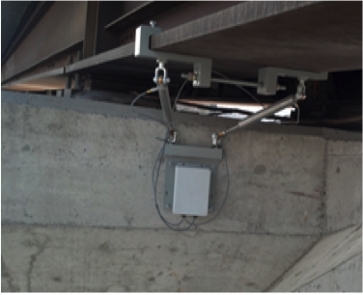
• Annex 1
Sensor attached to a bridge and its supporting pier to measure movement of the bridge relative to the pier and rockers in all three axes over time and ambient temperature.
Image from: alliance sensors group

Slide 23
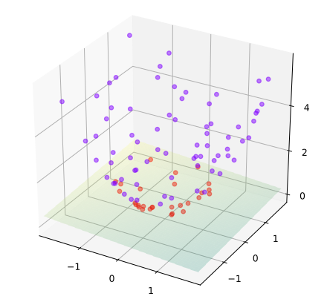
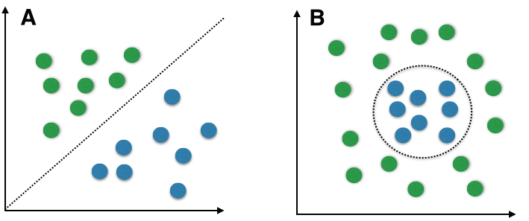
• Annex 2
• Kernels
Kernels help extracting information from the input space through projecting it to a higher dimension.
Commonly used in classification problems (i.e. SVM).
Classification Example:
B
Linearly separable data
Non-linearly separable data
Input Space *
Input Space *
Kernel Space *
* Figures from Wikipedia

